Slide 1
Computer Networks
Khizar Mukhtiar
Department of Computer Science
National University of Computer & Emerging Sciences

Slide 2
Lecture 3
Protocols and Architecture

Slide 3
Recap
Computer network
Switching strategies
Network topologies
Data flow in networks

Slide 4
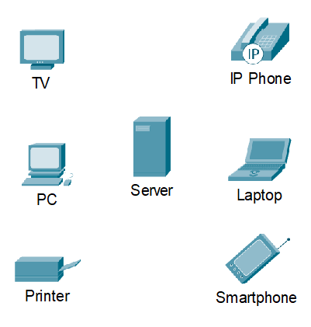
Devices
End Device
  Has an address on a network
  when sending a message, must specify the address of the destination end device
  Is either the source (sends a message) or destination (receives a message)

Slide 5
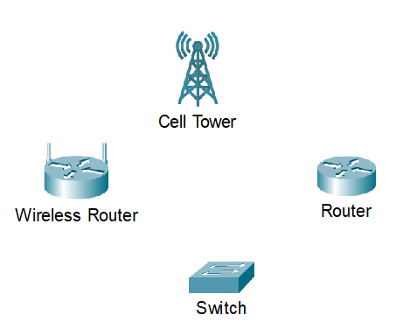
Devices
Intermediary Device
  Connects end devices
  Connects multiple individual networks to build an internetwork
  Ensures connectivity and data flow across the network
  While determining the path for forwarding messages, intermediary devices must have the destination end device address and information about the route (network interconnections)

Slide 6
Network Media
Copper Cables
Fiber Optic Cables
Wireless Transmission

Slide 7
Copper Cables
The farther the signal travels, the more it deteriorates. This is referred to as signal attenuation.
The timing and voltage values are affected from two sources:
  Electromagnetic interference (EMI) or radio frequency interference (RFI)
  Crosstalk

Slide 8
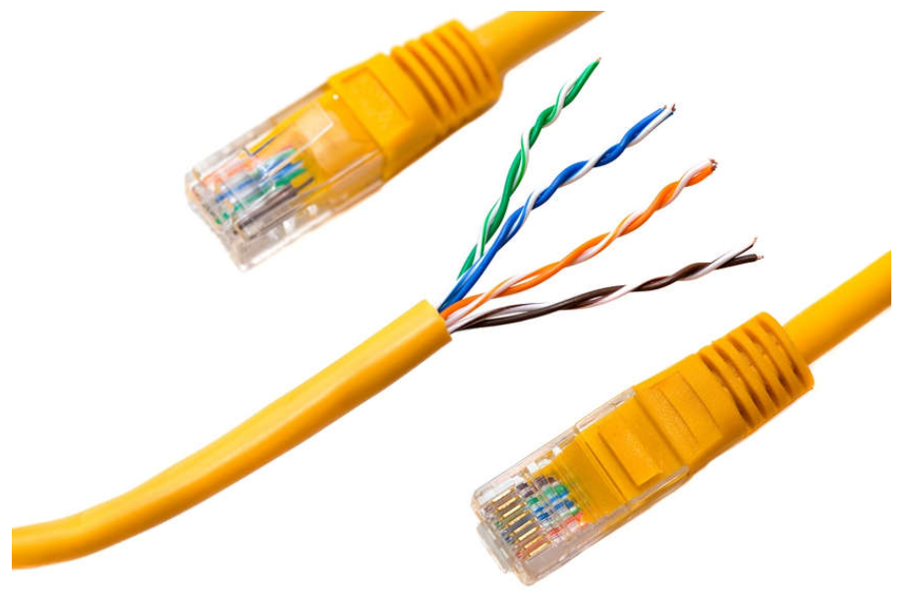
Copper Cables
Twisted-Pair Cable
Ethernet technology generally uses twisted-pair cables to interconnect devices.
Because Ethernet is the foundation for most local networks, twisted-pair is the most commonly encountered type of network cabling.
In twisted-pair, wires are grouped in pairs and twisted together to reduce interference.
The pairs of wires are coloured so that you can identify the same wire at each end.
Typically, in each pair, one of the wires is a solid color and its partner is the same color striped onto a white background.

Slide 9
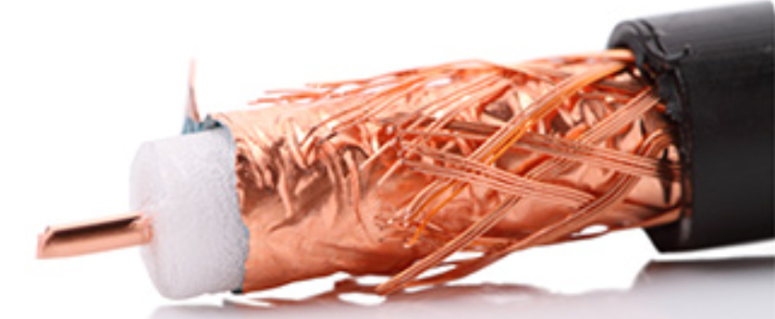
Copper Cables
Coaxial Cable
Coaxial was one of the earliest types of network cabling developed.
Coaxial cable is the kind of copper cable used by cable TV companies.
It is also used for connecting the various components which make up satellite communication systems.
Coaxial cable has a single rigid copper core that conducts the signal.
This core is typically surrounded by a layer of insulation, braided metal shielding, and a protective jacket.
It is used as a high-frequency transmission line to carry high-frequency or broadband signals.

Slide 10
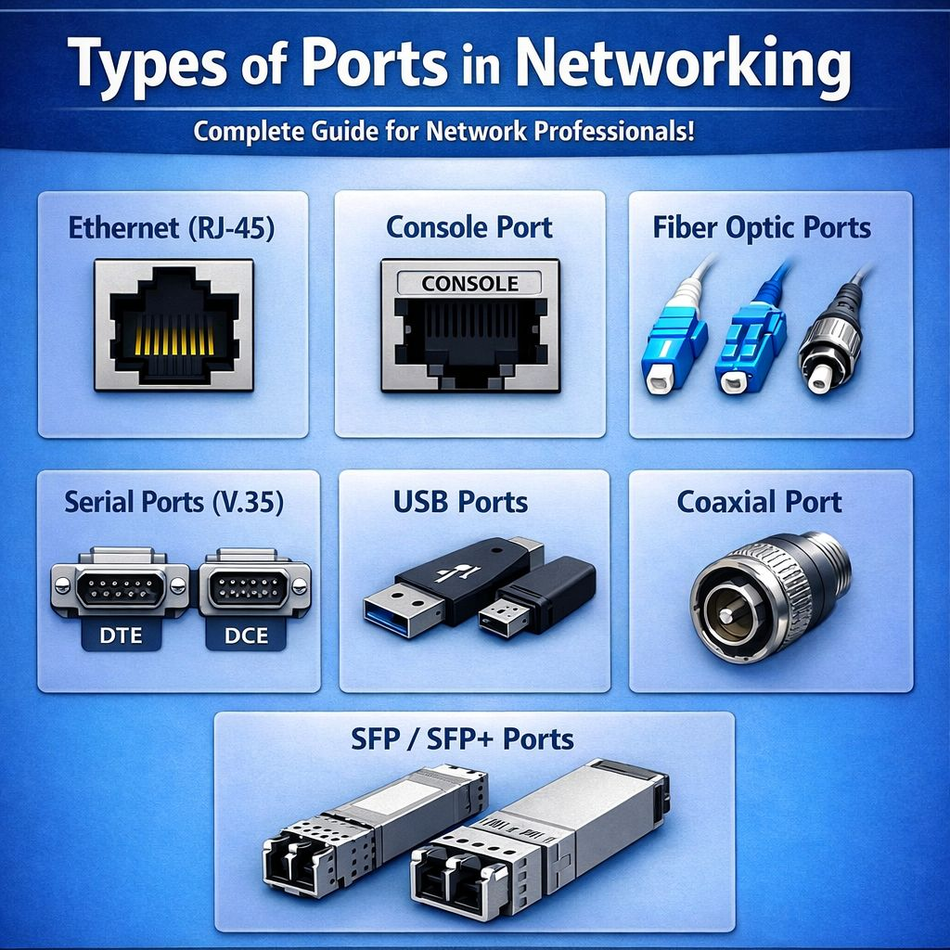
Types of Copper Cable
Unshielded Twisted-Pair Cable (UTP)
  Terminated with RJ-45 connector
  Connects hosts with intermediary devices
Shielded Twisted-Pair Cable (STP)
  Better noise protection
  More expensive and difficult to install
  Uses RJ-45 connector
  Terminated with special shielded STP data connectors
Coaxial Cable
  Two conductors that share the same axis that is why the name coaxial
  Different connectors be used
  Bayonet Neill-Concelman (BNC), N-type, and F-type
  Used in
    Wireless Installations
    Cable Internet Installations

Slide 11
Unshielded Twisted-Pair Cable (UTP)
Does not use shielding to counter the effects of EMI and RFI.
Instead, the paired wires are twisted that do the following
  Cancellation
  Varying the number of twists per wire pair
UTP Cabling Standards
  Cable Types
  Cable Lengths
  Connectors
  Cable Termination
  Methods of Testing Cable
Electrical Characteristics are defined by IEEE
  Cables are placed into categories based on their ability to carry higher bandwidth rates

Slide 12
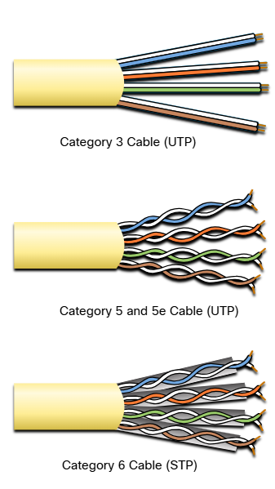
Unshielded Twisted-Pair Cable (UTP)
Category 3: used for voice communication over voice lines, but later used for data transmission
Category 5 and 5e: used for data transmission. Category 5 supports 100 Mbps and 5e supports 1000 Mbps
Category 6: has an added separation between each wire pair to support higher speeds. Category 6 supports up to 10 Gbps.
Category 7: supports 10 Gbps
Category 8: supports 40 Gbps

Slide 13
Straight-through and Crossover UTP Cables
Ethernet Straight-through cable connects different devices
Ethernet Crossover connects same devices.
But now has become legacy as NICs use medium-dependent interface crossover (auto-MDIX)

Slide 14
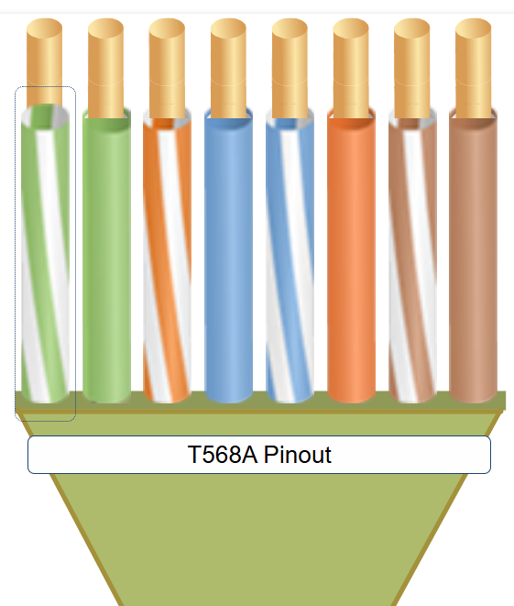
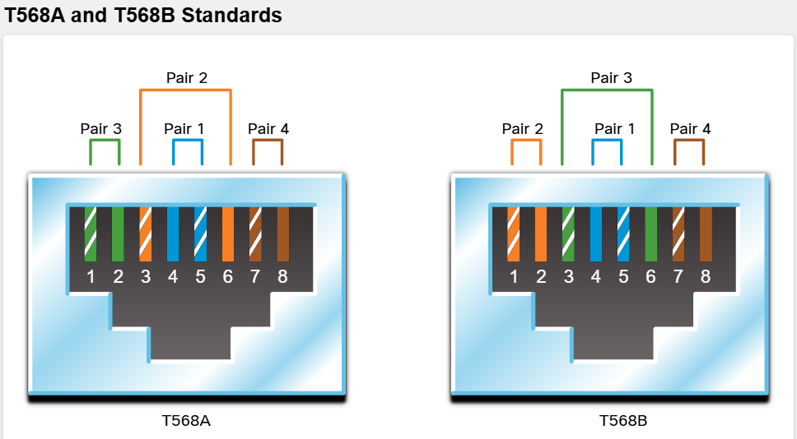
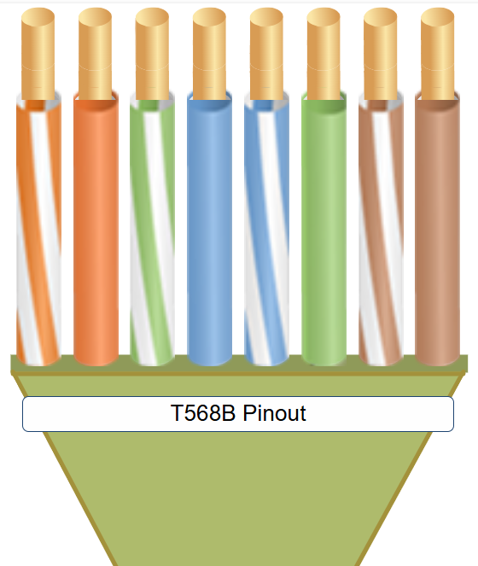
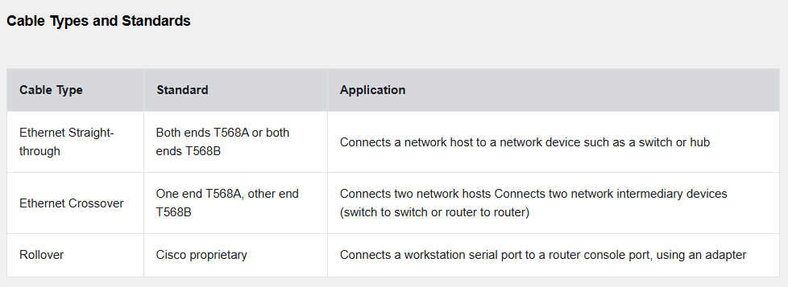

Slide 15
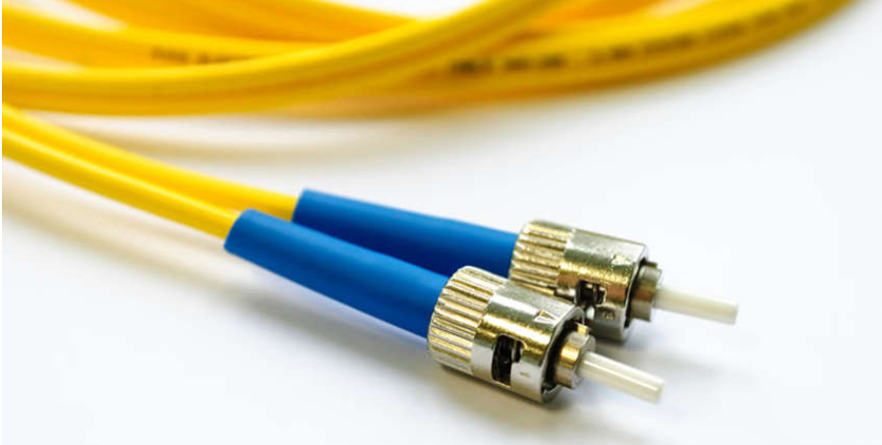
Fiber Optic Cabling
Fiber-Optic Cable
Fiber-optic cable can be either glass or plastic with a diameter about the same as a human hair
It can carry digital information at very high speeds over long distances.
Because light is used instead of electricity, electrical interference does not affect the signal.
Fiber-optic cables have many uses as well as communications.
They are also used in medical imaging, medical treatment, and mechanical engineering inspection.
They have a very high bandwidth, which enables them to carry very large amounts of data.
Fiber is used in backbone networks, large enterprise environments, and large data centers.
It is also used extensively by telephone companies.

Slide 16
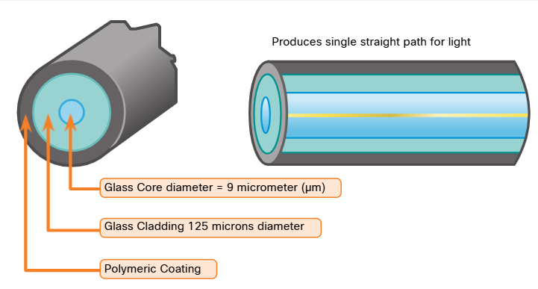
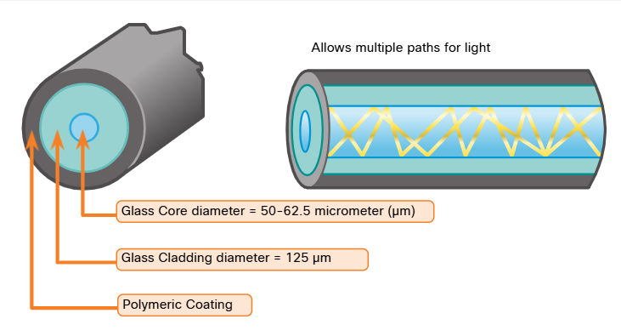
Fiber Optic Cabling
Single-mode Fiber (SMF)
  Single straight path for light
  For long distances over hundreds of kilometers
Multimode Fiber (MMF)
  Uses LED emitters
  Popular in LANs because of low-cost LEDs
  Provides up to 10Gbps bandwidth over the length of 550 meters
Dispersion refers to spreading out of light pulse over time
Increased dispersion means increased loss of signal strength
MMF has greater dispersion than SMF
That is why MMF can travel up to 500 meter before signal loss

Slide 17
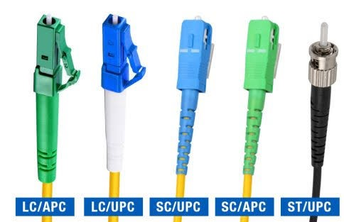
Fiber optic connectors
Straight-Tip (ST) Connector – twist on/ twist off
Subscriber Connector (SC) Connector – square connectors or standard connectors – push pull mechanism
Lucent Connector (LC) Simplex Connector – smaller version of SC connector
Duplex Multimode LC Connector – similar to LC connector but uses a duplex connector
Yellow jacket for SMF and Orange for MMF

Slide 18
Wireless Media Standards
Wi-Fi (IEEE 802.11)
  WLAN uses contention-based protocol
  Carrier sense multiple access / collision avoidance (CSMA/CA)
  The wireless NIC must first listen before transmitting to determine if the radio channel is clear.
Bluetooth (IEEE 802.15)
  Wireless Personal Area Network (WPAN) standard commonly known as Bluetooth
  1 to 100 meter range
WiMAX (IEEE 802.16)
  Worldwide Interoperability for Microwave Access (WiMAX)
  Uses point-to-multipoint technology to provide wireless broadband access
Zigbee (IEEE 802.15.4)
  Specification for low-data rate, low-power communications
  Intended for applications that require short-range, low-data rates, and long battery life
  Used for industrial and IoT environments such as wireless light switches, and medical device data collection

Slide 19
Other Terminologies
Network Interface Card (NIC) provides physical connection between the end devices and the network
Physical Port is a connector on a networking device where the media connects to an end device or another networking device
Interface is a specialized port on a networking device that connect to individual networks. The ports on a router are usually referred to as network interfaces
Port and interface are usually used interchangeably

Slide 20

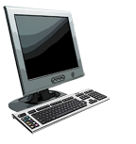

What’s a protocol?
Set of Rules that define format, order of msgs sent and received among network entities, and actions taken on msg transmission, receipt
a human protocol
computer network protocol
TCP connection
request
Salam
W Salam
TCP connection
response
Got the Time?
Get www.bbc.com
2:00PM
<file>
time

Slide 21
Network Protocol Requirements
Message encoding
  Process of converting information into another acceptable form for transmission.
  Decoding reverses this process to interpret the information.
Message formatting and encapsulation
  Envelop has the address of the sender and receiver, each located at the proper place on the envelop
  Destination address and formatting must be correct
Message size
Message timing
  Flow Control
    Rate of data transmission
  Response Timeout
    Response should be received in finite amount of time
  Access Method
    When someone can send a message

Slide 22
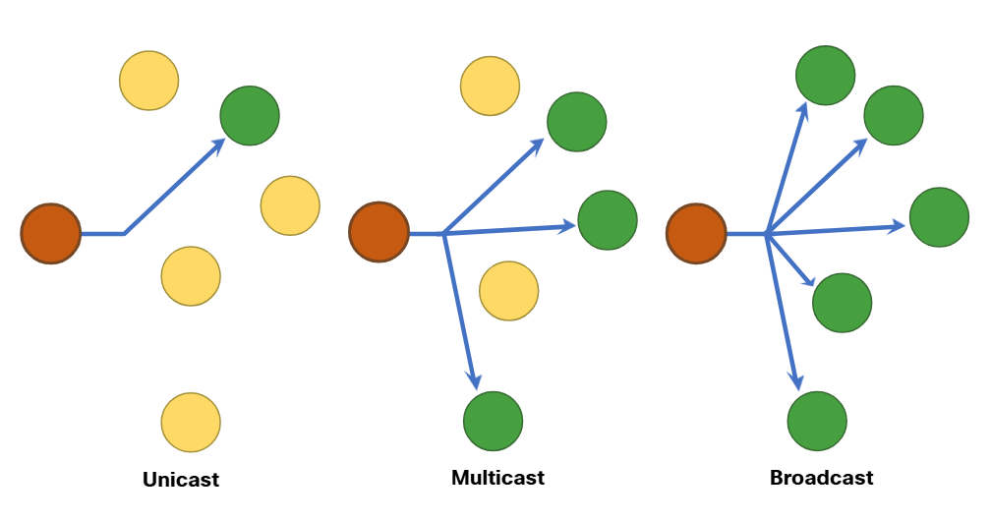
Network Protocol Requirements
Message delivery options
  Unicast information is being transmitted to a single end device
  Multicast information is being transmitted to one or more end device
    By default, switch will send this out on all ports except the incoming port.
    Only the intended receiver will process the message
  Broadcast information is being transmitted to all end device

Slide 23
Protocol Types
Network Communications Protocols
  enable two or more devices to communicate over one or more networks.
    HyperText Transfer Protocol (HTTP)
    Transmission Control Protocol (TCP)
Network Security Protocols
  secure data by providing authentication, data integrity, and encryption.
    Transport Layer Security (TLS)
    Secure Shell (SSH)

Slide 24
Protocol Types
Routing Protocols
  enable routers to exchange routing information, compare available paths, and select the best path to the destination network.
    Open Shortest Path First (OSPF)
Service Discovery Protocols
  support automatic detection of devices or services on a network.
    Dynamic Host Configuration Protocol (DHCP)
    Domain Name System (DNS)

Slide 25
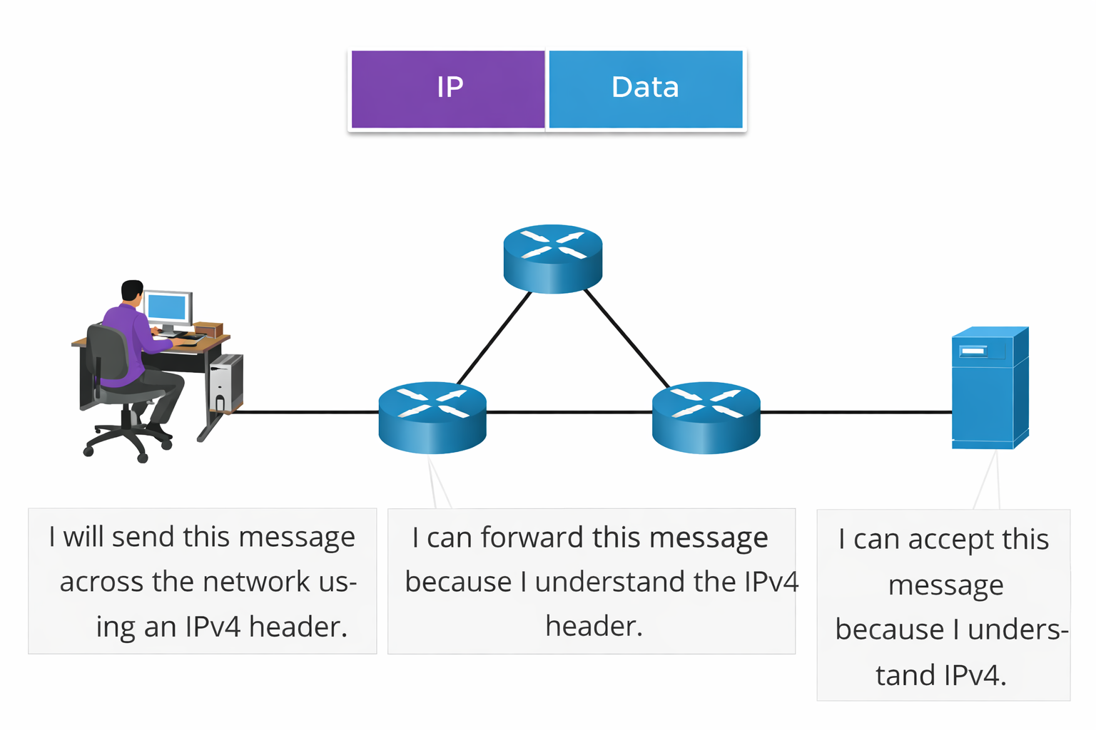
Communication Example

Slide 26
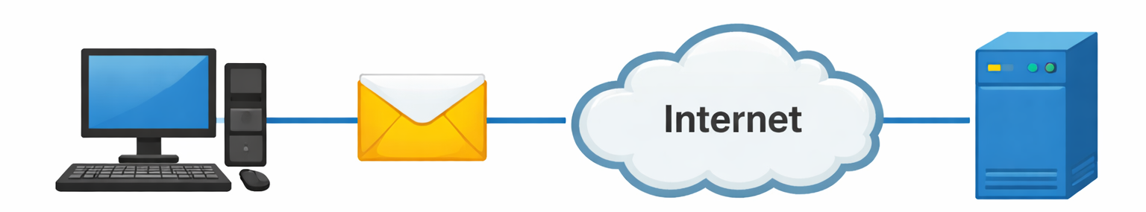
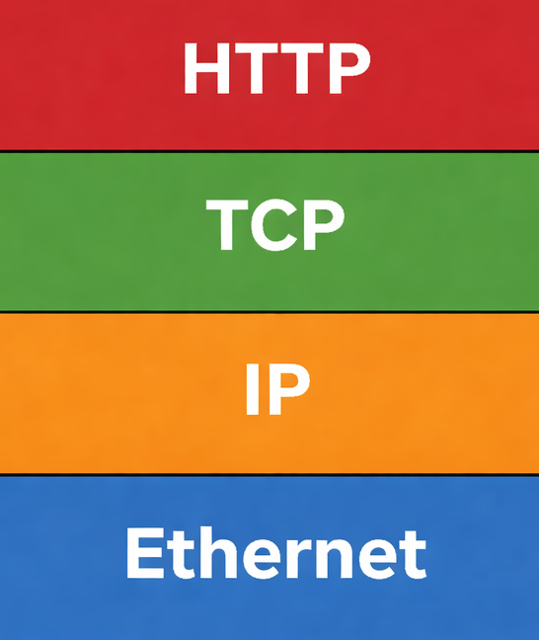
Handles web client–server request and response exchange
Ensures reliable, ordered data delivery
Routes packets across interconnected networks
Transfers frames between devices on local network

Slide 27
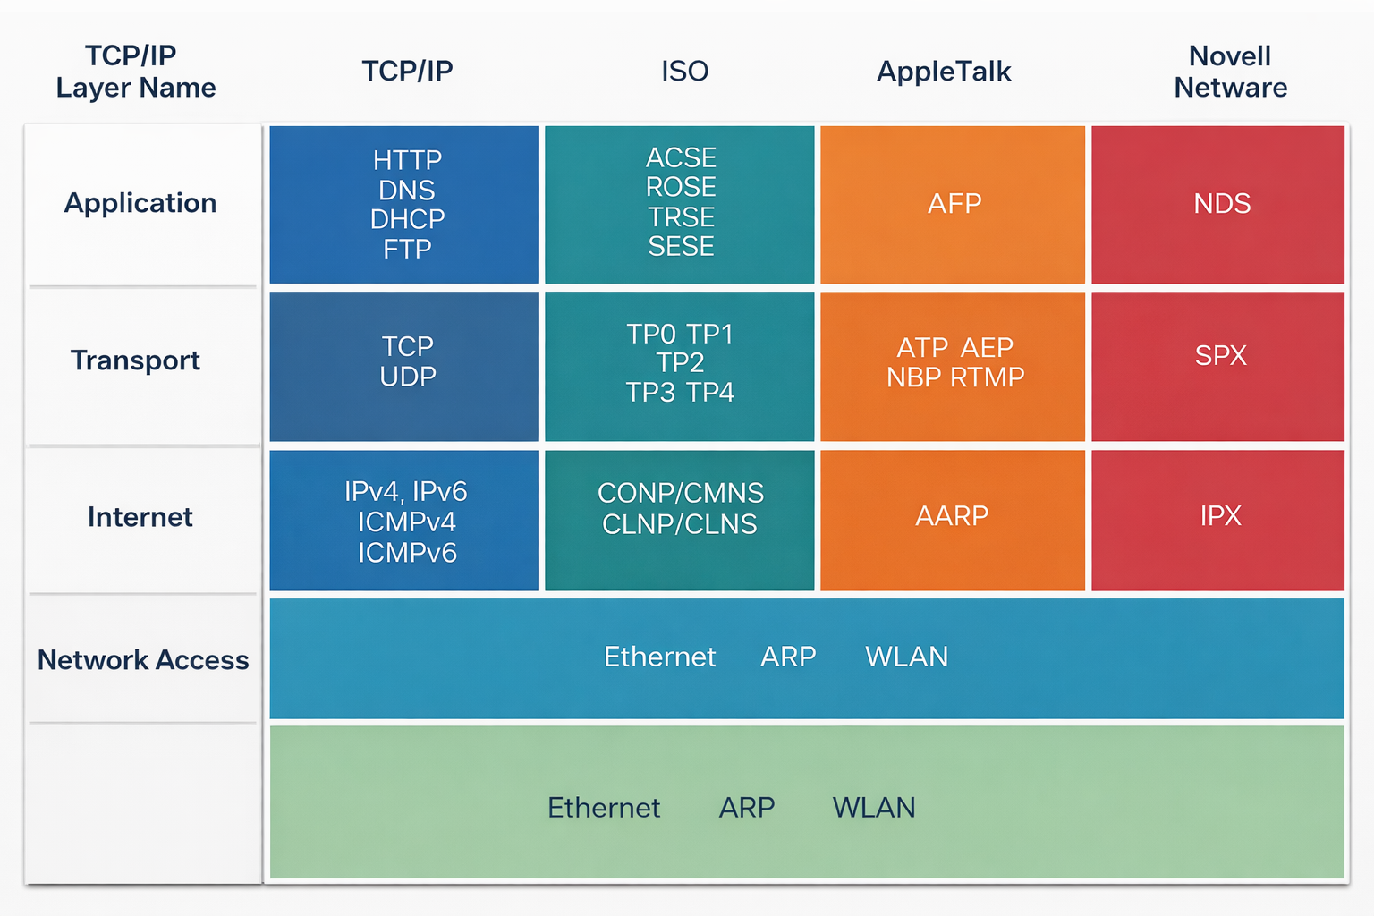
Network Protocol Suite
A protocol suite is a group of inter-related protocols necessary to perform a communication function.

Slide 28
Network Protocol Suite
Internet Protocol Suite (TCP/IP):
  It is the widely used protocol suite that forms the foundation of modern Internet communication
  It is an open-standard protocol suite maintained by the Internet Engineering Task Force (IETF)
Open Systems Interconnection (OSI) Protocols:
  Developed jointly in 1977 by the International Organization for Standardization (ISO) and the International Telecommunication Union (ITU).
  Introduced the well-known seven-layer OSI reference model, which categorizes the functions of network protocols.
  Today, the OSI model is primarily used as a conceptual and educational framework, while its protocols have largely been replaced by TCP/IP.
AppleTalk:
  AppleTalk was a short-lived proprietary protocol suite released by Apple Inc. in 1985 for Apple devices.
  In 1995, Apple adopted TCP/IP, effectively replacing AppleTalk.
Novell NetWare:
  A short-lived proprietary protocol suite and network operating system developed by Novell Inc. in 1983, using the IPX network protocol.
  In 1995, Novell adopted TCP/IP, replacing IPX.

Slide 29
Standard
Essential in creating and maintaining an open and competitive market for equipment manufacturers
Guaranteeing national & international interoperability of data & telecommunication technology & process
Internet Standards
  RFC: Request for Comments
  IETF: Internet Engineering Task Force

Slide 30
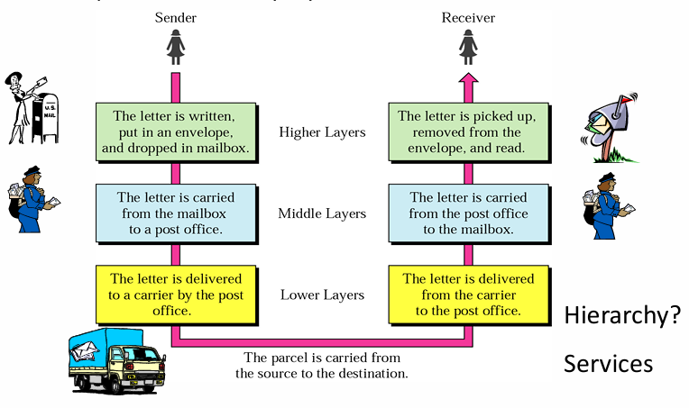
Layered Tasks
An example from everyday life

Slide 31
Organization of air travel
a series of steps
Time
Time
ticket (purchase)
baggage (check)
gates (load)
runway takeoff
airplane routing
ticket (complain)
baggage (claim)
gates (unload)
runway landing
airplane routing

Slide 32
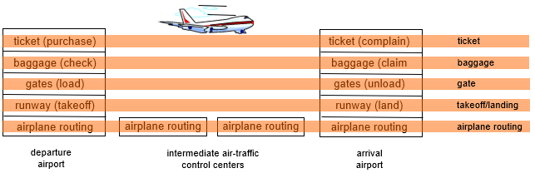
Layering of airline functionality
layers: each layer implements a service
  via its own internal-layer actions
  relying on services provided by layer below/above
Notes:
32

Slide 33
Why layering?
Communication system involves complex procedures
Better if task is broken into subtasks and arranged in a sequence
Identify relationship between the subtasks
Implement separately in layers in stack
Each layer relies on services provided by layer below/above
This modularization eases maintenance and updating of system
  Changes in one layer is transparent to rest of system
  e.g., change in gate procedure doesn’t affect rest of system
Each layer has its own task
Each layer has its own protocol

Slide 34
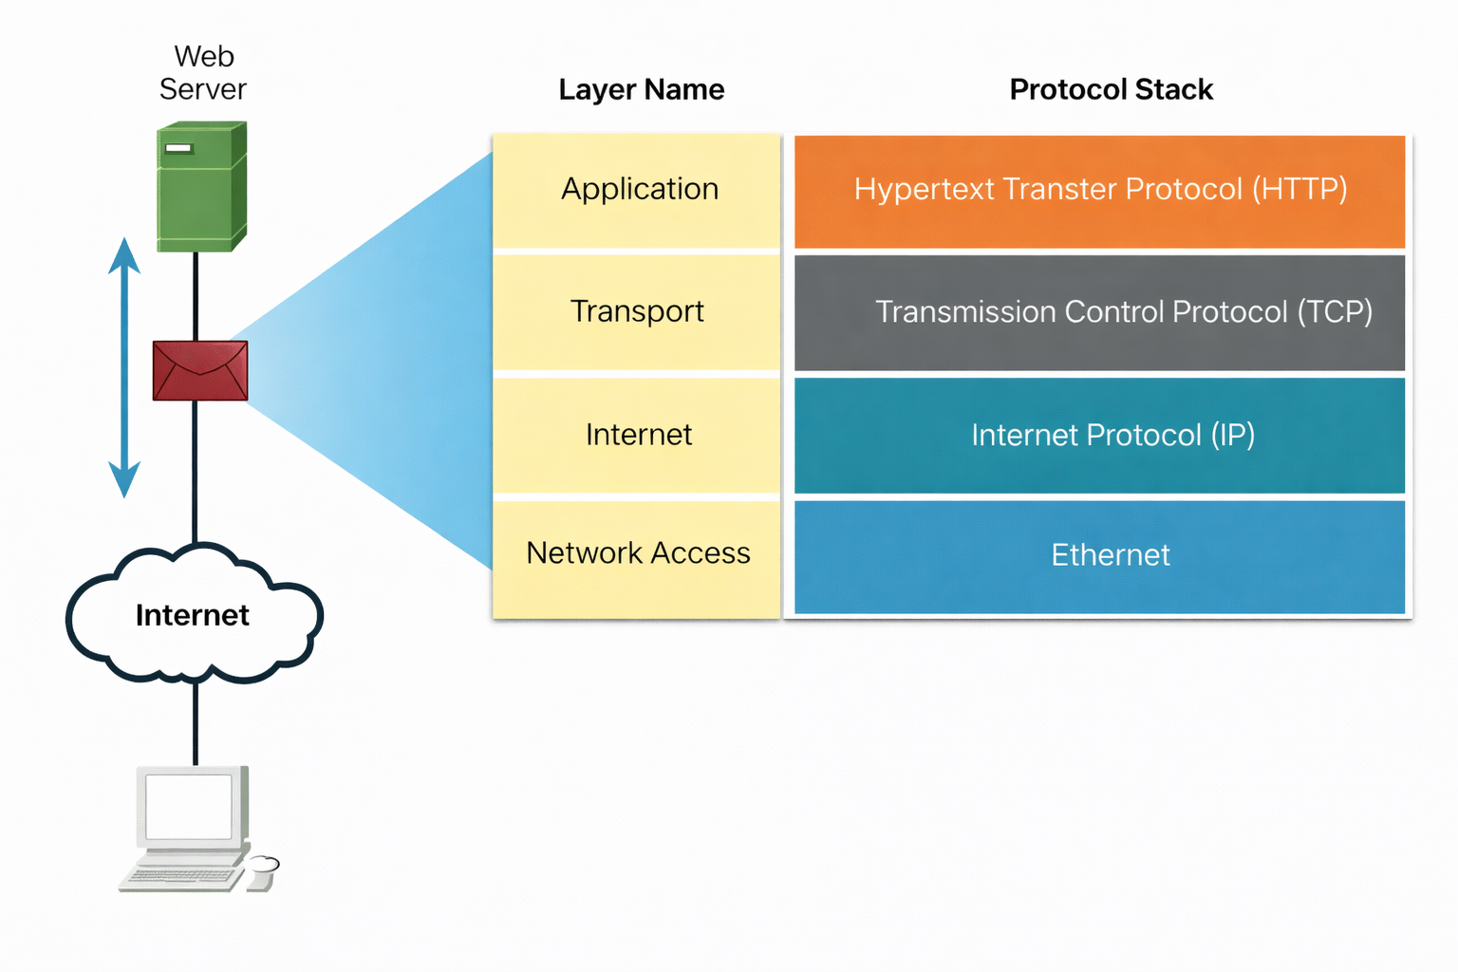
TCP/IP Protocol Example
Not available at the Network Access Layer
Most common Network Access Layer protocols are Ethernet protocols
TCP/IP protocols include HTTP, TCP, IP, at application, transport and internet layers respectively
TCP/IP Model Layer | Description
4 – Application | Represents data to the user, including encoding and dialog control.
3 – Transport | Supports end-to-end communication between devices across networks.
2 – Internet | Determines the best path for data through the network.
1 – Network Access | Controls hardware devices and transmission media of the network.

Slide 35
TCP/IP Protocol Architecture
Developed by the US Defense Advanced Research Project Agency (DARPA) for its packet switched network (ARPANET)
Used by the global Internet
No official model but a working one.
  Application layer
  Host to host or transport layer
  Internet layer
  Network access layer
  Physical layer

Slide 36
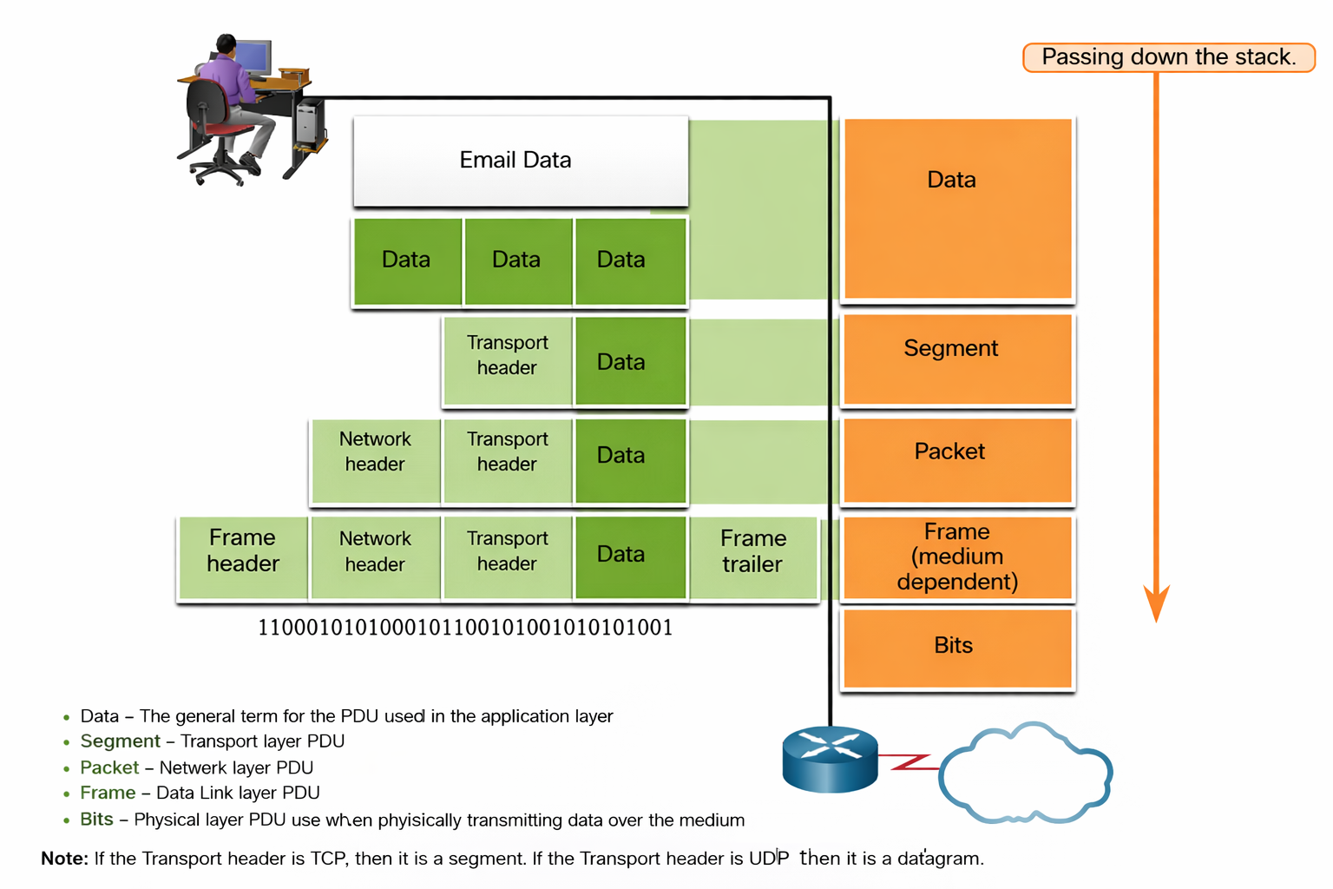
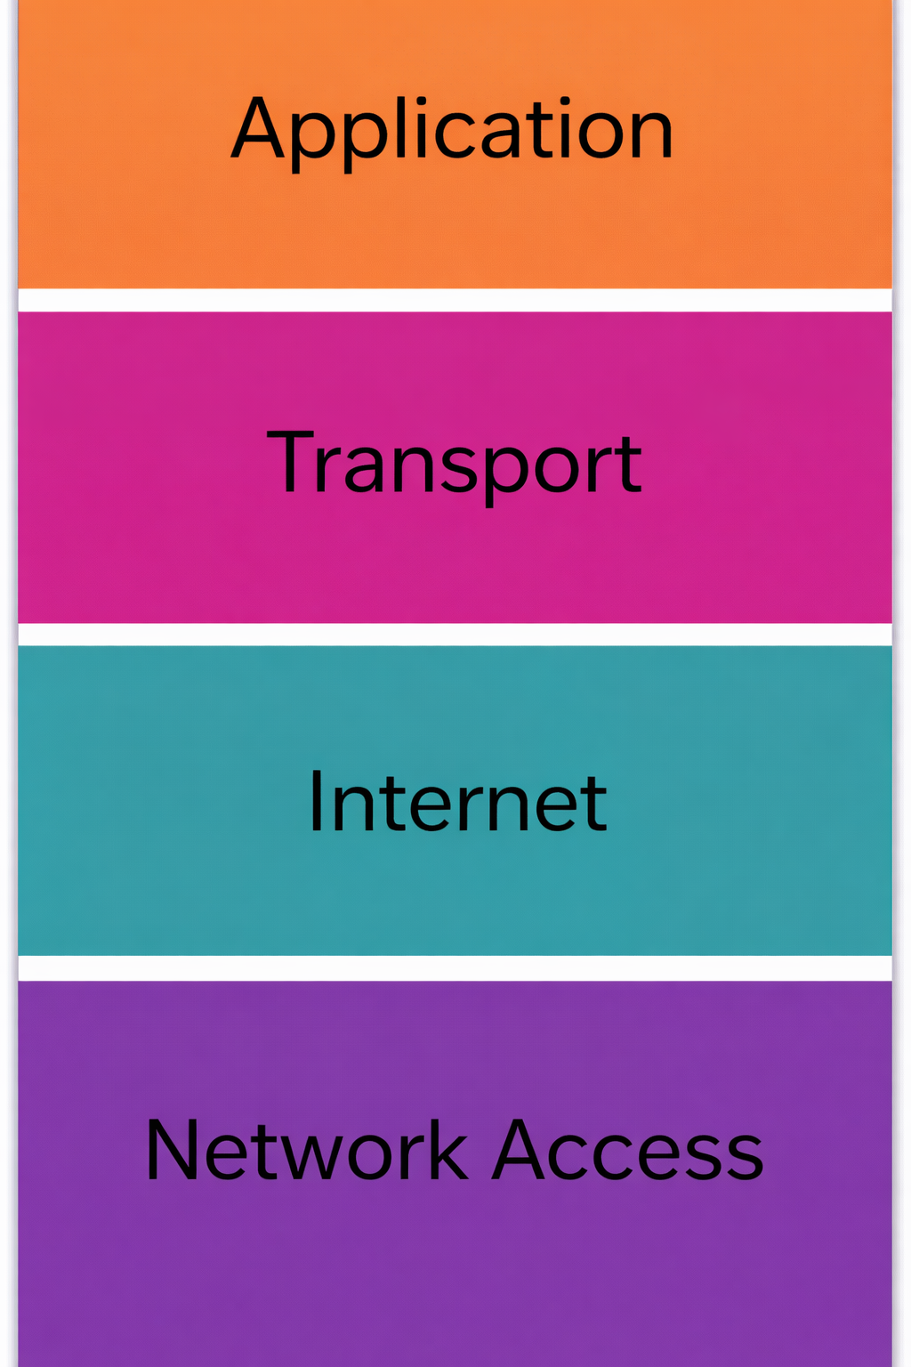

Slide 37
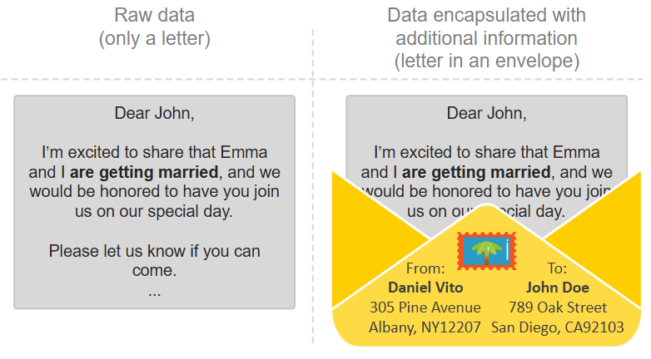
Data Encapsulation
As application data is passed down the protocol stack on its way to be transmitted across the network media, various protocol information is added at each level.
This is known as the encapsulation process.

Slide 38
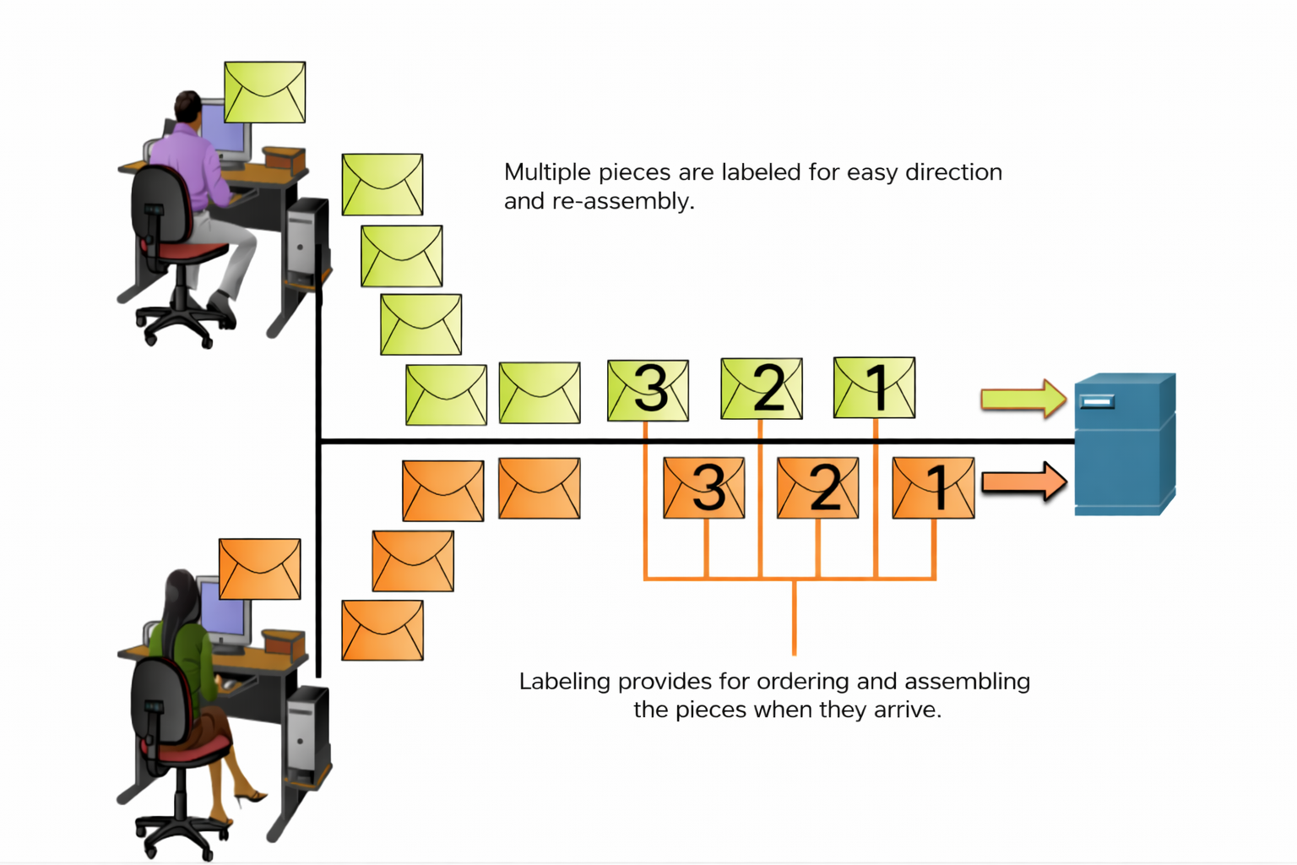
Sequencing
TCP is responsible for sequencing the individual segments.

Slide 39
Protocol Data Units (PDU)
User Datagram Protocol (UDP) PDU is called datagram
IP packets are called IP datagrams
At each layer, different protocols may be used
Control information is added to user data at each layer
The form that a piece of data takes at any layer is called a protocol data unit (PDU).
During encapsulation, each succeeding layer encapsulates the PDU that it receives from the layer above in accordance with the protocol being used.
Notes:
User Datagram Protocol (UDP) is a fast, connectionless, and lightweight internet protocol that sends data packets (datagrams) quickly without establishing a formal connection, prioritizing speed over guaranteed delivery, order, or error-checking, making it ideal for real-time applications like gaming, streaming, and DNS lookups where speed is crucial and occasional packet loss is acceptable. It's simpler and has less overhead than TCP, often described as "fire and forget," but lacks reliability features like handshakes and guaranteed packet arrival.
Key Characteristics:
Connectionless: Sends data without a prior handshake or established session, reducing latency.
Unreliable: Offers no guarantee of delivery, order, or duplicate protection; packets can be lost or arrive out of sequence
Lightweight: Minimal overhead due to its simple structure, making it fast.
Transport Layer: Works on top of IP (Internet Protocol) to provide communication between applications.

Slide 40
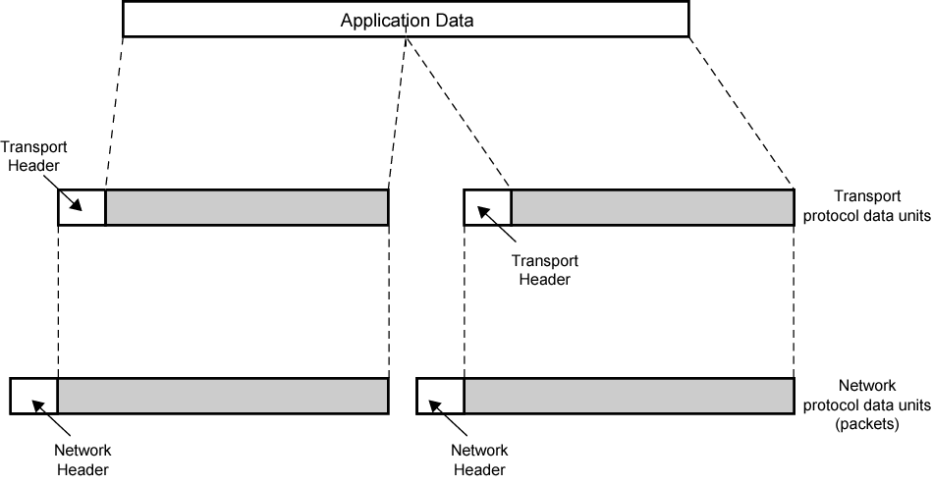
Protocol Data Units

Slide 41
Standardized Protocol Architectures
Required for devices to communicate
Vendors have more marketable products
Customers can insist on standards-based equipment
Two standards:
  OSI Reference model
  TCP/IP protocol suite
Also: IBM Systems Network Architecture (SNA)

Slide 42
OSI Model
Open Systems Interconnection
Developed by the International Organization for Standardization (ISO)
A layered model - Seven layers
Each layer performs a subset of the required communication functions
Each layer relies on the next lower layer to perform more primitive functions
Each layer provides services to the next higher layer
Changes in one layer should not require changes in other layers

Slide 43
OSI Layers
The OSI model, or Open Systems Interconnection model, is a framework that breaks down the encapsulation process into seven layers.
Each layer has a specific role and handles a part of the encapsulation, such as data formatting, logical addressing, routing, physical addressing, or error checking.
The OSI model gives a step-by-step structure for how data encapsulation should work:
  Each layer has a specific job, like adding source and destination addresses or checking for errors.
  Each layer uses specific protocols that follow agreed-upon rules.
  Each layer adds its own header (and sometimes trailer) to the message, so the receiving system knows how to process it.

Slide 44
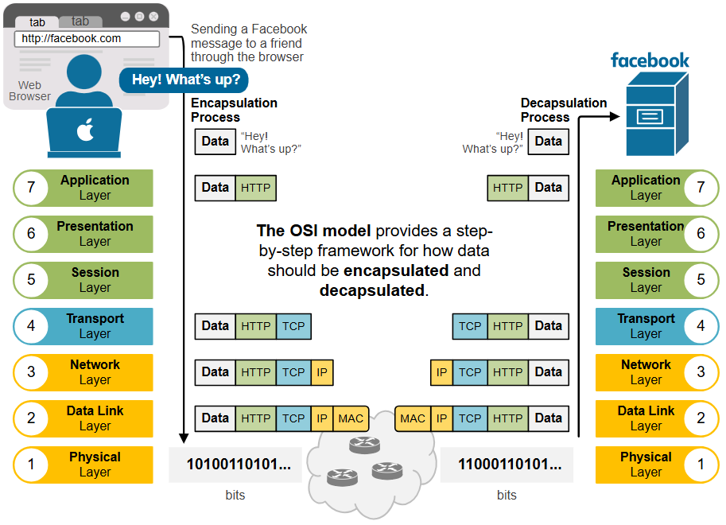
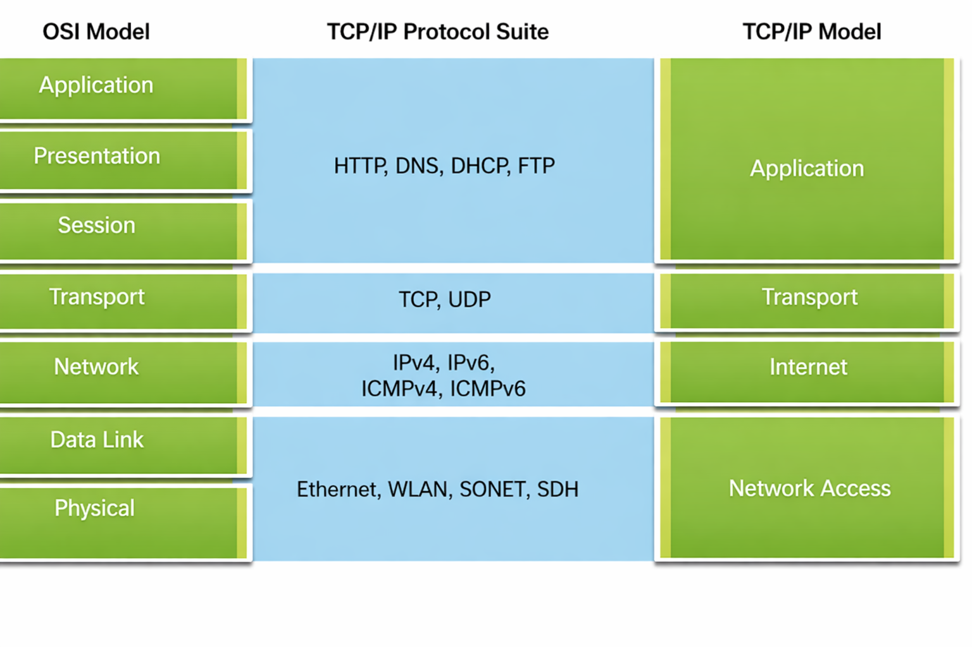

Slide 45
The primary goal of the OSI model is to establish a standard and vendor-agnostic data encapsulation framework.
It helps different devices and systems work together by following the same set of rules and standards.

Slide 46
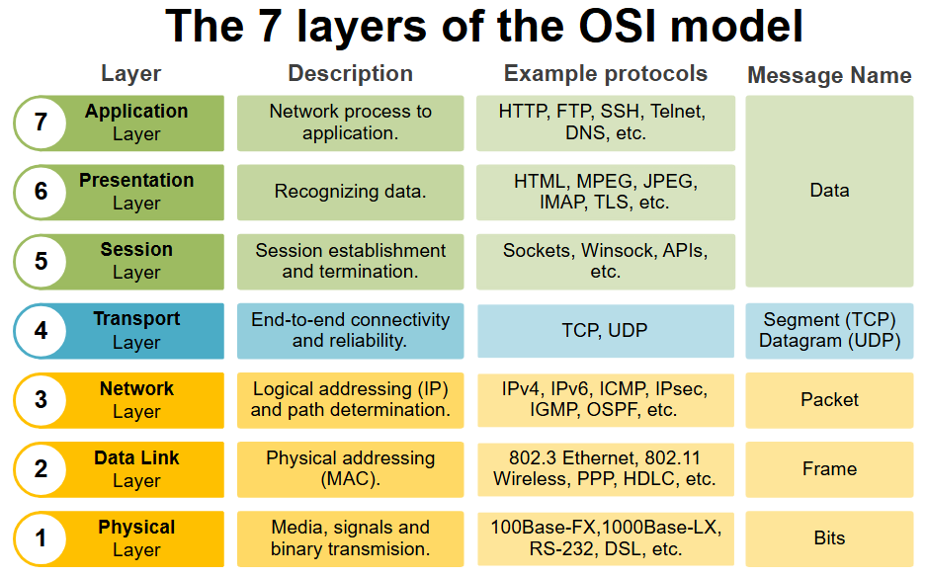

Slide 47
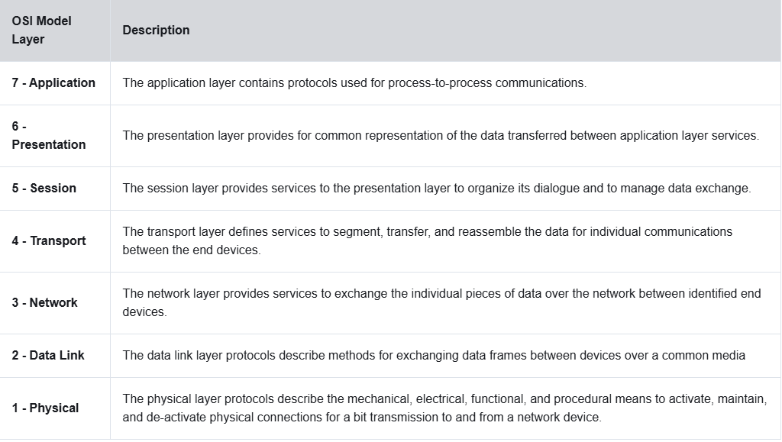

Slide 48
OSI Layers (Physical Layer)
Physical layer is the lowest layer of the OSI model.
  It is responsible for sending bits from one computer to another.
  This layer is not concerned with the meaning of the bits
  It deals with the setup of physical connection to the network and with transmission and reception of signals.
  Representation/Encoding of Bits: The bits must be encoded into signals for transmission.
  Data Rate
  Synchronization
  Interface
  Transmission Modes: Simplex, Half / Full Duplex

Slide 49
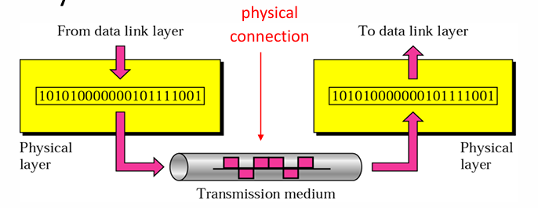
Physical Layer
Transporting bits from one end node to the next
type of the transmission media (twisted-pair, coax, optical fiber, air)
bit representation (voltage levels of logical values)
data rate (speed)
synchronization of bits (time synchronization)

Slide 50
OSI Layers (Data Link)
Data link layer performs the most reliable node to node delivery of data.
  It create frames from the packets that are received from network layer and gives it to physical layer.
  Flow Control
  Error detection and control
  Access Control
  Higher layers may assume error free transmission

Slide 51
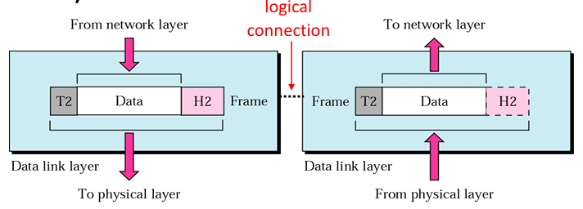
Data Link
Transporting frames from one end node to the next one
Framing
Physical addressing

Slide 52
OSI Layers (Network Layer)
The main aim of this layer is to deliver packets from source to destination across multiple links (networks).
Transport of information
Routers and gateways operate in the network layer
Higher layers do not need to know about underlying technology
Responsible for:
  Logical Addressing
  Routing
  Switching

Slide 53
OSI Layers (Transport Layer)
The transport layer is responsible for the delivery of a message from one process to another.
Segmentation and Reassembling
Connection Control:
  Connectionless
  Connection Oriented
Flow Control: In this layer, flow control is performed end to end.
Error Control: Error Control is performed end to end in this layer to ensure that the complete message arrives at the receiving transport layer without any error. Error Correction is done through retransmission.
Quality of service

Slide 54
OSI Layers (Session and Presentation Layers)
Session Layer
  The session layer is responsible for dialog control and synchronization.
  The session Layer allows users on different machines to establish active communication sessions between them.
Presentation Layer
  The presentation layer is responsible for translation, compression, and encryption.

Slide 55
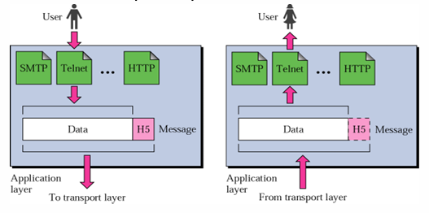
OSI Layers (Application Layer)
Application Layer
  It is the topmost layer of OSI Model.
  The application layer is responsible for providing services to the user.
  It enables user or software to get access to the network.
  Provides services to a user
    Remote file access and transfer (Telnet, FTP)
    E-mail (SMTP)
    Access to the WWW (HTTP)

Slide 56
OSI Reference Model
A convenient aid for remembering the OSI layer names is to use the first letter of each word in the phrase:
All People Seem To Need Data Processing

Slide 57
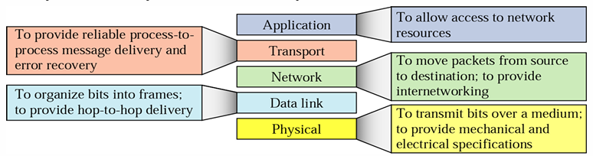
Summary
Low-level protocols define the electrical and physical standards to be observed, bit- and byte-ordering and the transmission and error detection and correction of the bit stream
High-level protocols deal with the data formatting, including the syntax of messages, the terminal to computer dialogue, character sets, sequencing of messages

